Slide 1



Nurse strengthening Project
Present By:
Ahmed-Yasin, (Rn, HSM ,MSc)
Matron of HGH
and
Asma Hassan,(Rn, Psych MSc)
SLNMA consultant

Slide 2


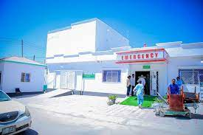
About HGH
Hargeisa Group Hospital was established in 1953. It is a 460-bed hospital, located in Hargeisa, is the largest public hospital in Somaliland, and offers healthcare facilities to patients of the city.

Slide 3

The reason the training is needed
1. Nurses after entering into professional healthcare delivery, have little time to academically update themselves further.
2. Nursing school education does not impart knowledge on the most current facts and data available in the nursing field. However, this information may quickly become outdated in the healthcare setting because the healthcare field is constantly changing and progressing. Thus there is an urgent need for conducting training programs for freshly recruited nurses and experienced nurses too especially in public sector hospitals such as Hargeisa General Hospital which are catering to a large population

Slide 4
The reason the training is needed
3. HGH is gearing toward a specialized health care services and that require specialized knowledgeable skillful nurses as HGH nowadays became higher in specialist services.
4. RN Josh Huang, Taiwan Medical Mission was assigned by Taiwan Ambassador & DG, MoHD to strengthen nursing care standards. Therefore, he reach out to HGH whom highlighted their need to improve current nursing care standards at HGH

Slide 5

General Objective
General Objective
This training is intended to orient the nurses on their roles and responsibilities and develop their communication, critical thinking and decision making skills to enable them to perform their jobs especially in improving the quality of health care to the public

Slide 6


Specific Objective
HGH and TMM wants nurses to take a structured approach to their training , assess their practice against the Standards for Practice and identify priority areas for learning and improvement by requiring them to:
Identify their learning needs based on an evaluation of their practice against recognized professional standards
Develop a brief learning plan based on the needs identified

Slide 7

The process
First commence with a short survey to include all nurses in HGH
The hospital nursing matron and senior management will be provided with a presentation about the whole process to obtain managerial support and staff commitment to get involved.

Slide 8
The ultimate outcomes of this project
induction training programs are to improve the professional practice of nursing and thereby the care that is provided by nurses to patients

Slide 9

The Process
3. The survey includes the following questions:
Name
Job title
Department
Gender
Education and qualification
Years of experience
Date of graduation from nursing school/college
Desire/ability to be a trainer
Last attended training program
Language proficiency (written and spoken)

Slide 10
The Process
3. All the surveys responses will be kept categorized in their departments to just select each shift trainer
4. After selecting the participants a checklist will be given to each participant followed by pre test questionnaire (25 questions) to assess the participants skills and knowledge
6. After gathering all these data a plan for the training will be laid out, determining the content of the training manuals and methods, venues..etc

Slide 11
TRAINING PHASE 1 FORMULATION
The outcome of the pre test/checklist and survey will guide the training phase 1 plan formulation
3
SELECTED PARTICIPATING NURSES ARE GIVEN A PRE TEST /CHECKLIST FOLLOWED BY INDIVIDUAL INTERVIEW
Every department head nurse and ea one nurse from each shift should be represented in the selected participants.
2
1
SURVEY FOR EVERY DEPARTMENT NURSES
Standardized questions given to every department nurses that hospital admin agree on
THE PROCESS

Slide 12
HGH Nurses‘ Knowledge Survey Results
Outcome of survey assessment is illustrated below:
Age | NO | %
20-29 | 44 | 80
30-39 | 9 | 16
40-49 | 1 | 2
50-59 | 1 | 2
Sub-total | 55 | 100

Slide 13
Gender | NO | %
Male | 23 | 41
Female | 33 | 59
Sub-total | 56 | 100
3. Level of experience of nursing profession | NO | %
Less than 2 years | 9 | 16
2-5 years | 16 | 29
6-10 years | 27 | 48
11-20 years | 0 | 0
More than 21 years | 4 | 7
Sub-total | 56 | 100

Slide 14
Participant profession | NO | %
Nursing | 45 | 64
B. Midwife | 3 | 4
C. Public health | 14 | 20
D. Nutrition | 2 | 3
E. Laboratory | 3 | 4
F. Biomedical | 1 | 1
G. Health system management | 2 | 3
Sub-total | 70 | 100

Slide 15
Language you are fluent in | NO | %
Arabic | 2 | 4
B. Somali | 8 | 14
C. English | 16 | 29
D. I can’t understand English but am not fluent | 2 | 4
E. B and C | 15 | 27
F. A, B, and C | 13 | 23
Sub-total | 56 | 100

Slide 16
Last training you attend | NO | %
Last 6 months | 9 | 16
B. Last year | 12 | 21
C. I always keep myself updated with training regularly | 15 | 27
D. No | 20 | 36
Sub-total | 56 | 100

Slide 17
Do you have desire and quality to be trainer? | NO | %
Yes | 35 | 63
B. No | 13 | 23
C. Not sure | 8 | 14
Sub-total | 56 | 100
Would you like to participate training after this assessment? | NO | %
Yes | 51 | 91
B. No | 4 | 7
C. I don’t know | 1 | 2
Sub-total | 56 | 100

Slide 18
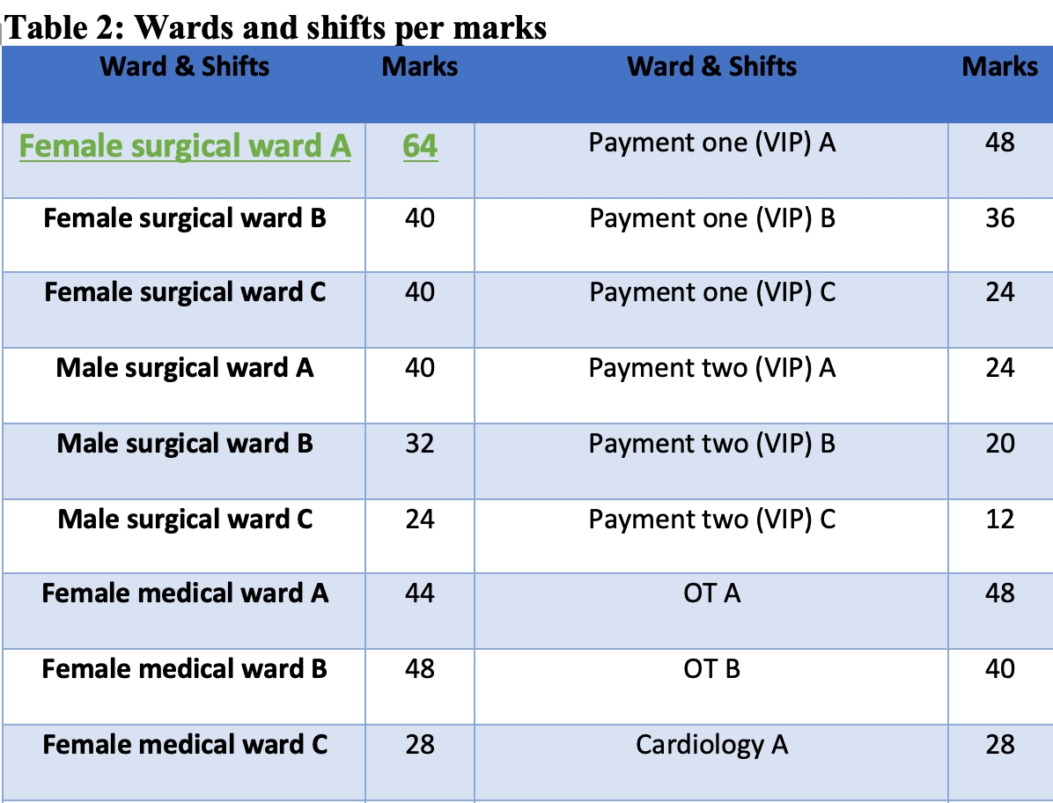

Slide 19
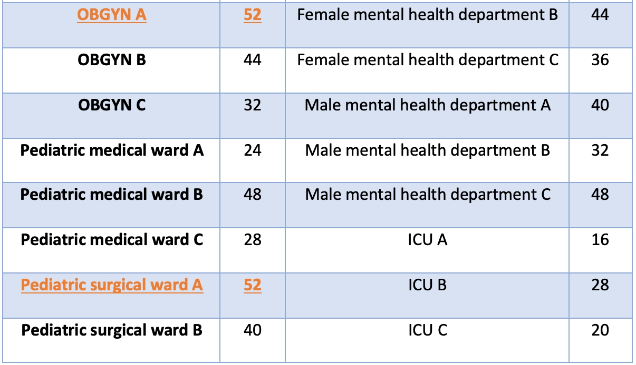

Slide 20
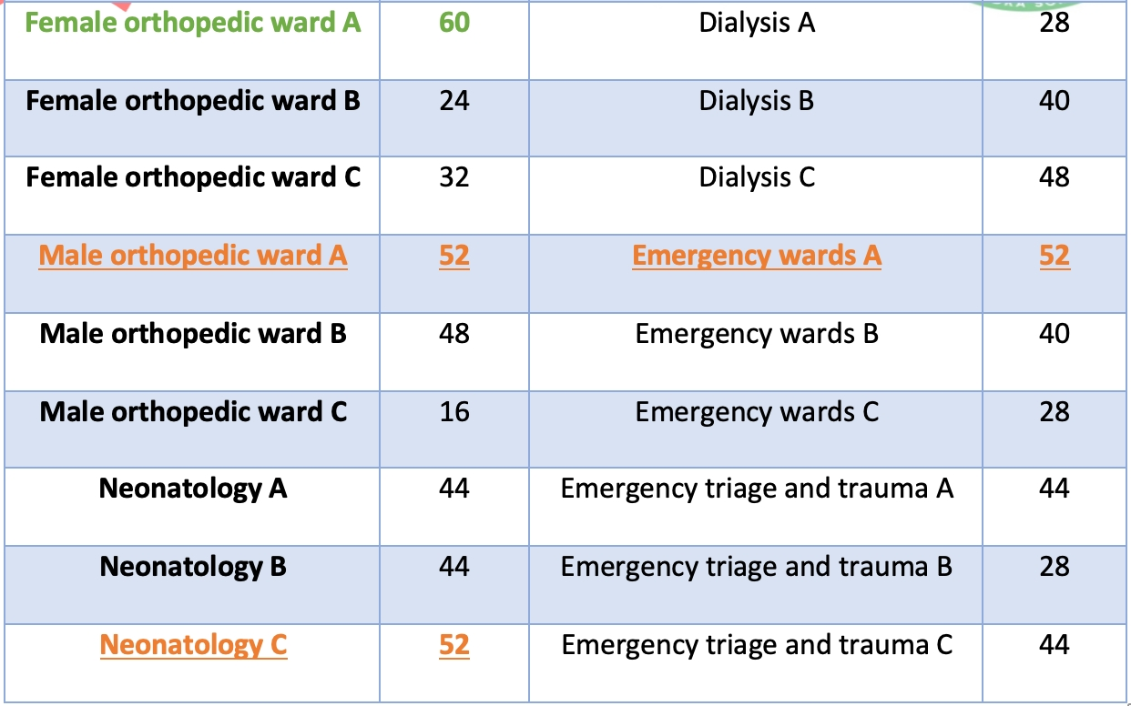

Slide 22
Marks | NO | Wards + Shifts
11-20 | 3 | ICU(A+C), MOW (C), Payment 2(B+C)
21-30 | 11 | ICU(B), FOW(B), Card(A), MSW(c), FMW(c), P2 (A), P1(C), PMW(A+C), DW(A), EW(C), ET and T(B)
31-40 | 12 | FOW(C), OT(B), Cardio(B+C), F Mental W (A+C), M mental W(A+B), MMW(A+C), FSW(B+C), MSW(A), P1(B), PSW(B+C), DW(B), EW (B).
41-50 | 10 | MOW(B), OT (A), F Mental W(B), M Mental W(C), FMW(A+B), P1(A), PMW(B), Neo (A+B), DW(C), ET and T (A+C)
51-60 | 6 | MOW (A), FOW(A), MMW(B), PSW(A), Neo(C), EW(A)
61-70 | 1 | FSW(A)

Slide 23
1. Identify the training needs through training need assessment | We developed training need assessments in the form of survey questionnaires and a pre-test of basic fundamental nursing. 56 nurses were enlisted and their data were collected and analyzed.
2. Set the objectives of training: | Phase 1: Fundamental Nursing Knowledge and Skills Strengthening & SOPs.
 | Phase 2: Specific Specialty Knowledge & Skills Strengthening & SOPs
3. Finalize the contents & topics for the training: | 23 Topics were identified, then after discussion with all the partners the 23 topics will have some that will merge
4. Prepare a training design: | We decided to opt out for different methodologies for different topics or sessions.

Slide 24
Variation of learning activities implemented in this training Phase 1
Categories of learning activities:
learning by doing one’s regular job (Nurses/Head Nurses job description and roles knowledge)
learning by applying something new in the job (introducing latest evidence based practices and knowledge in training contents)
learning by social interaction with colleagues (Implementing group activities(assignments) for nurses to share ideas, express challenges, identify new solutions to challenges)
learning by theory or guidance (introducing SOP for each topic in training and train nurses on it)
learning by thinking about work experiences( open discussion for nurses to share experiences)

Slide 25



Nurse strengthening Project
PHASE 1

Slide 26
50 topics were selected as per the need assessment outcome but SLNMA and UOH suggested pairing of certain topics to attempt cutting down days of training as requested by HGH administration and management.
A call was made to SLNMA, UOH, HGH , Gollis university, and Frantz fanon University nursing departments instructors and qualified trainers to submit their CV’s for review
Finalized topics and instructor schedule was developed

Slide 27
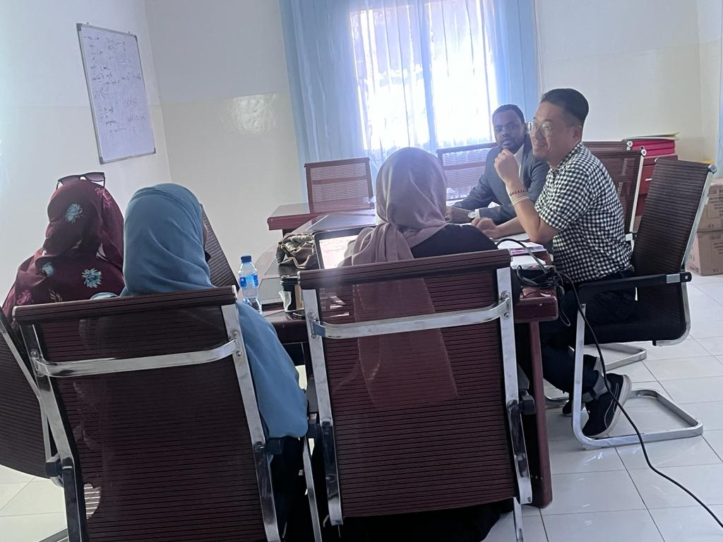

Slide 30
Preparation for phase 1 kick off
MOU agreement with the supervising consultant | Developed by TMM
MOU agreement with the instructor | Co-developed by TMM ,SLNMA ,and UOH
Participants welcoming letter | Developed by SLNMA consultant Asma
Participants rules and responsibilities letter | Developed by SLNMA consultant Asma
Supervising consultant evaluation form of the instructor | Developed by SLNMA consultant Asma
Orientation to all instructors conducted via zoom or in person | Done by UOH , SLNMA ,TMM
Banner design (in Somali language) | TMM
Venue provision | HGH
Media, invitation letters, and snack provision | TMM

Slide 31


Slide 32
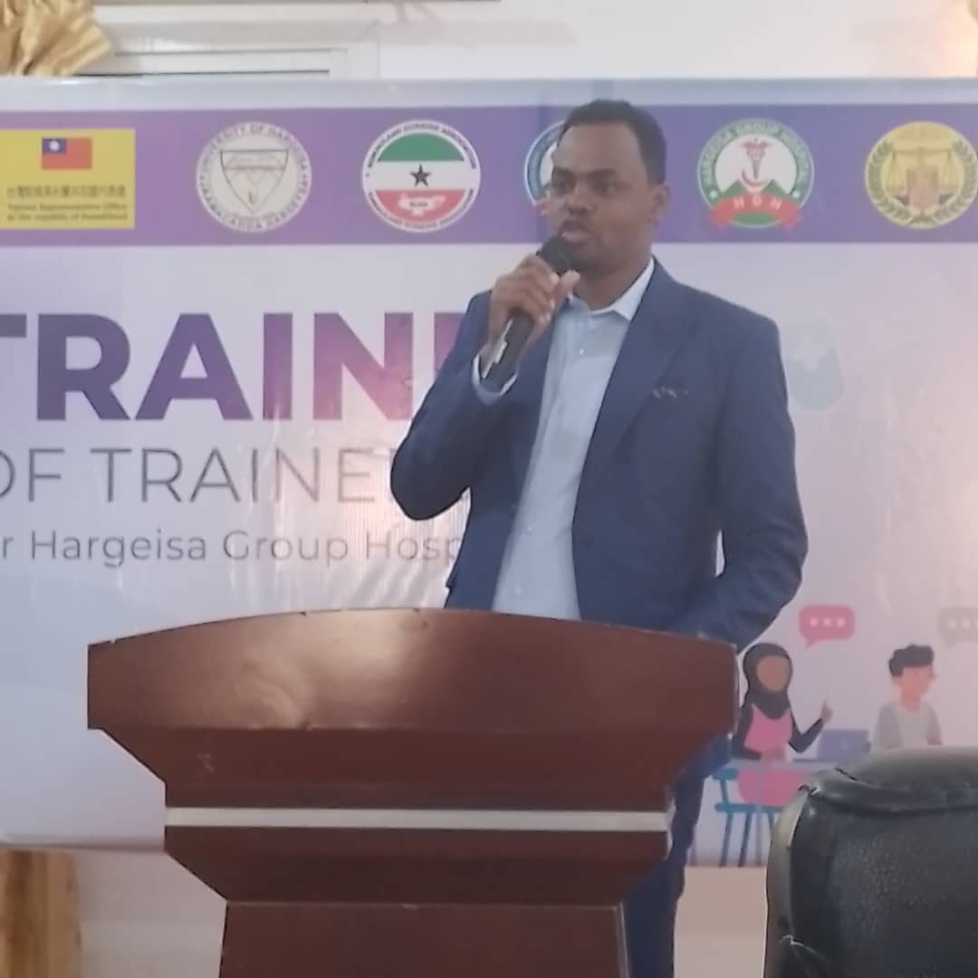
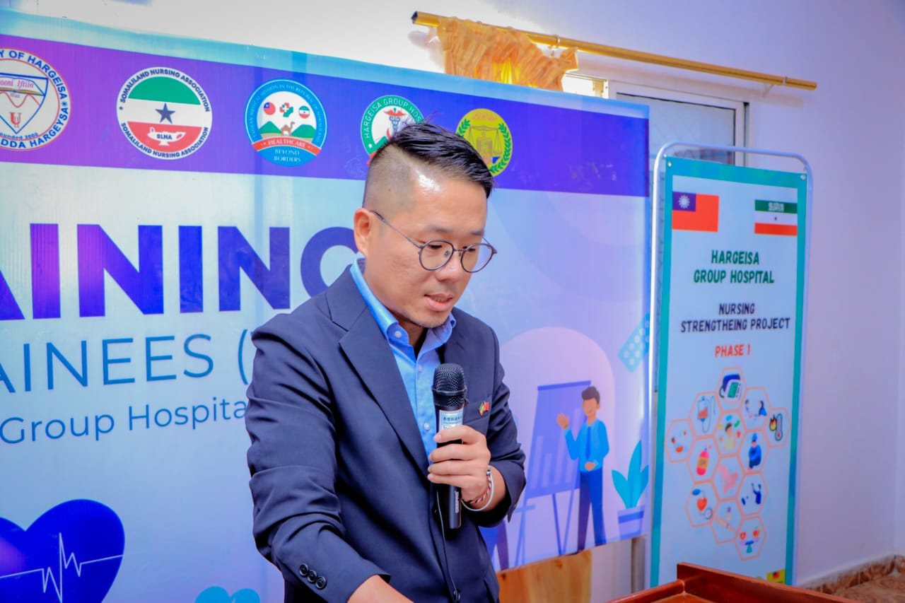
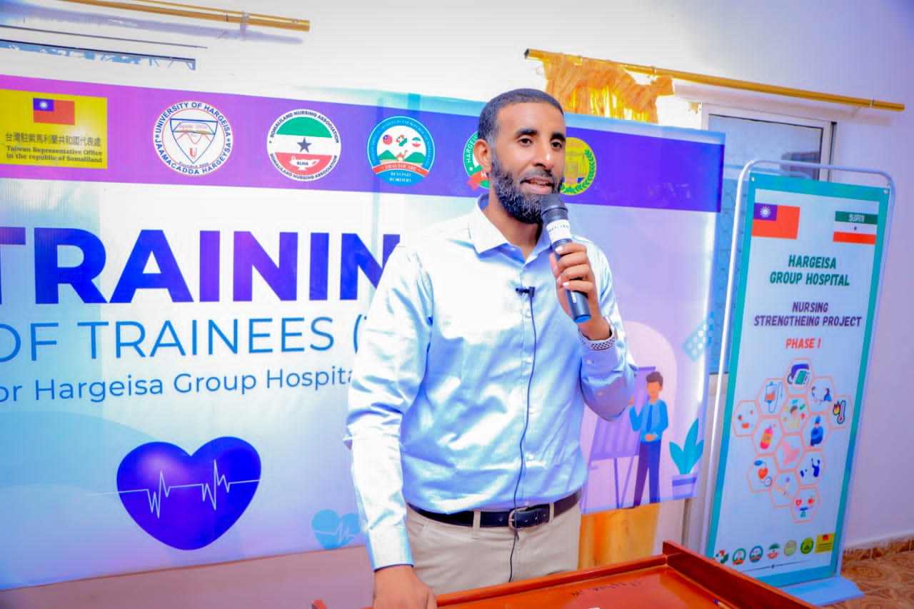
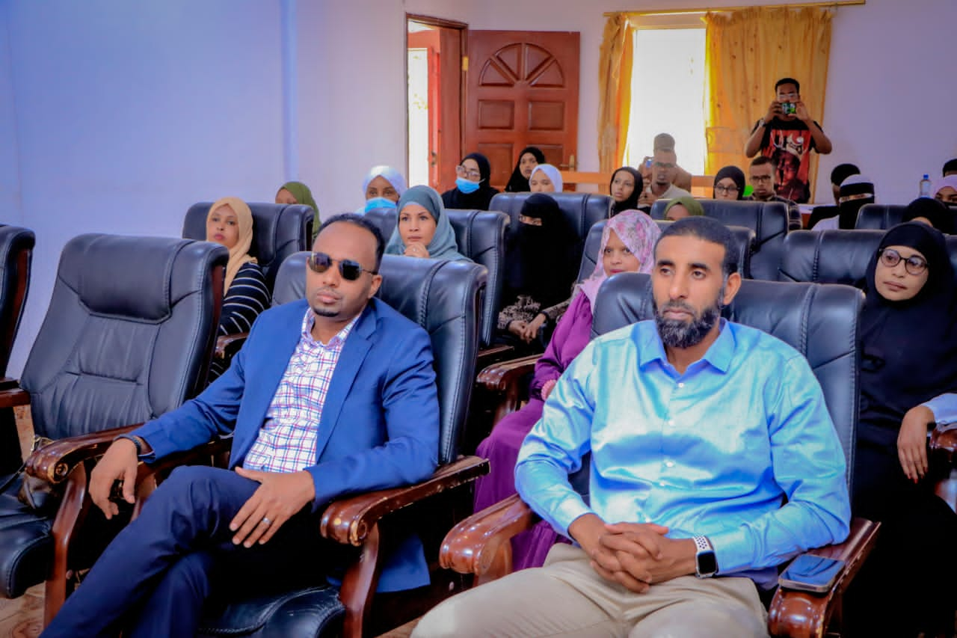
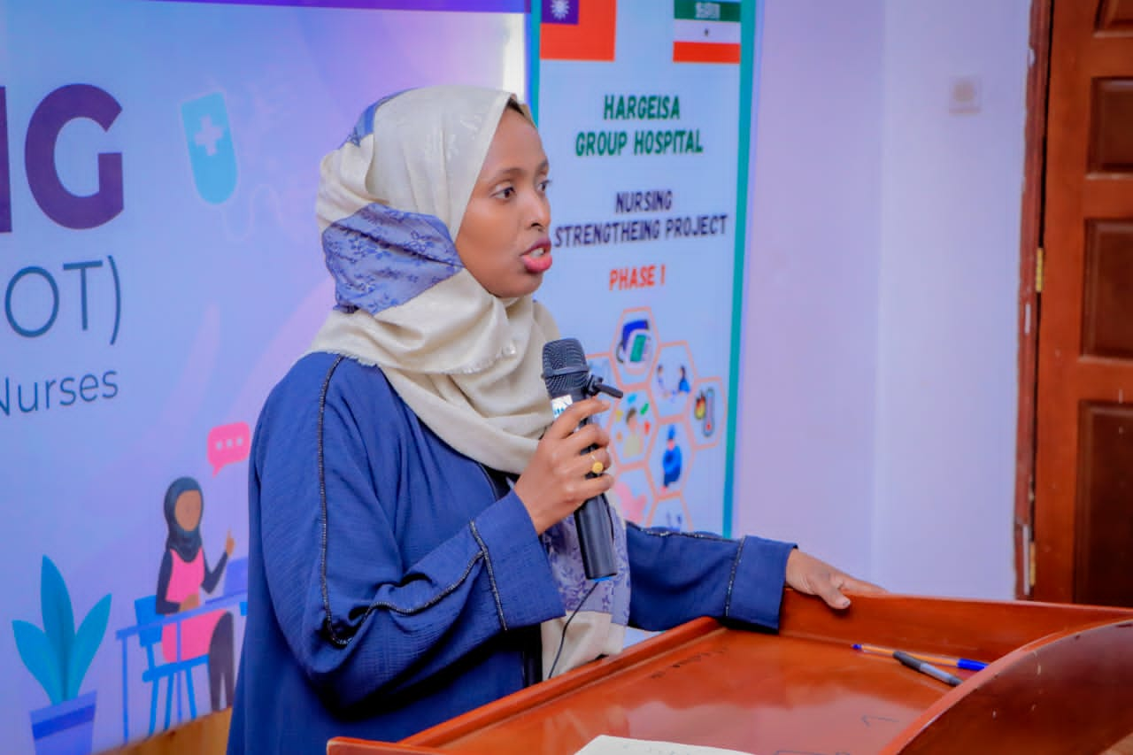

Slide 33
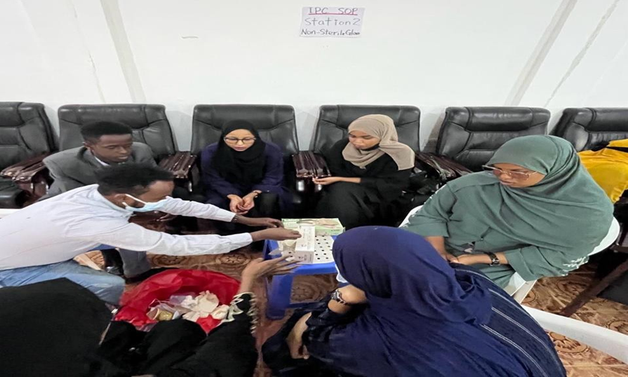
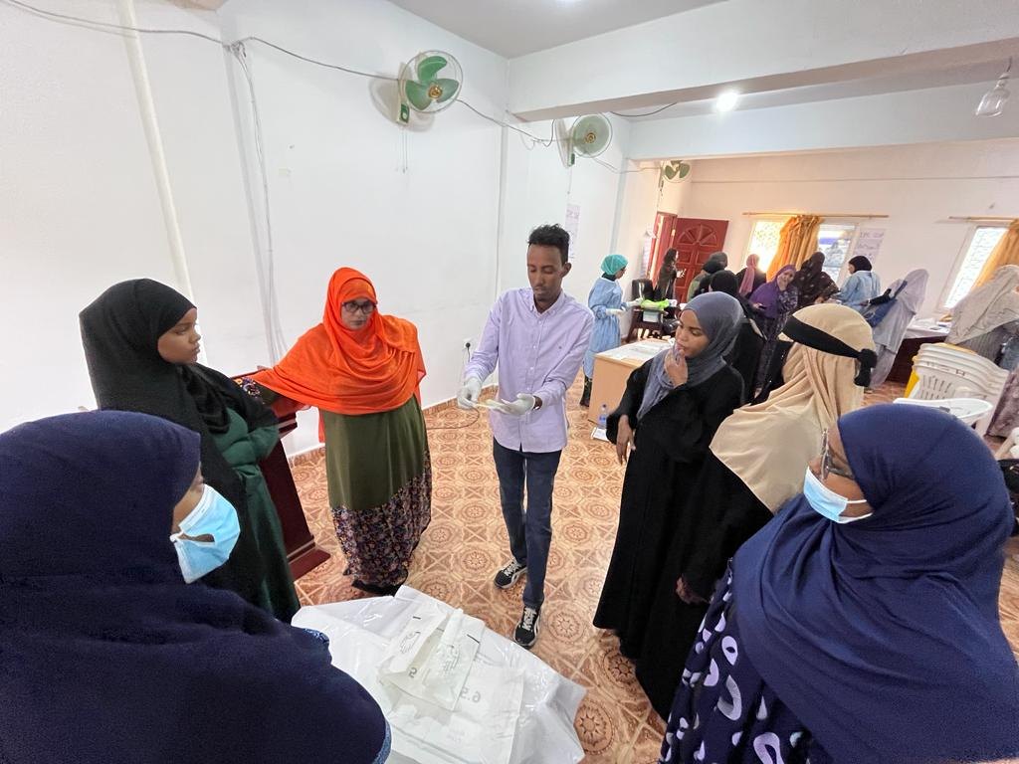
Topic 1: Infection Prevention and Control training 1/8/2023 for 4 days

Slide 34
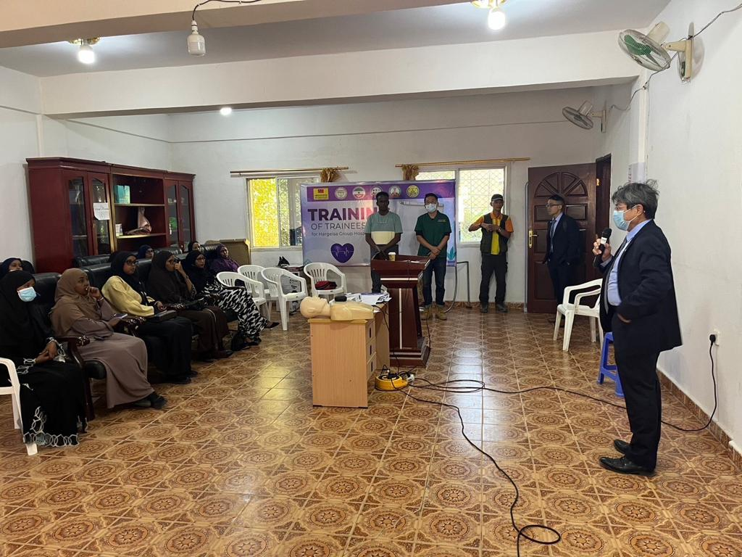

Slide 35
A special thanks to: HGH TMM UOH SLNMA HGH nurses

